Slide 1
Using Data to Make Decisions
Dev Nambi
Data Geek
University of Washington
@DevNambi
me@devnambi.com
Notes:
Message:
Story To Tell:

Slide 2
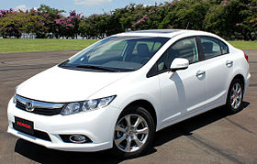
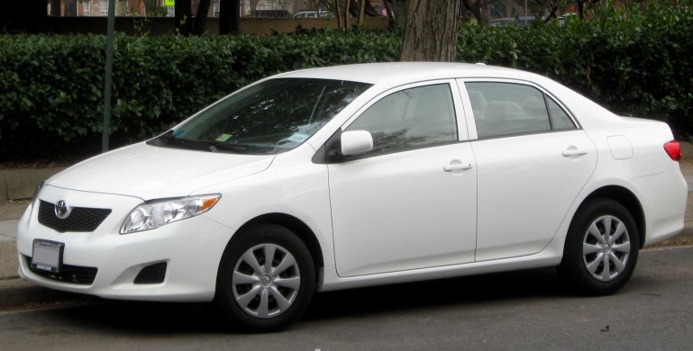
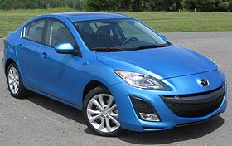

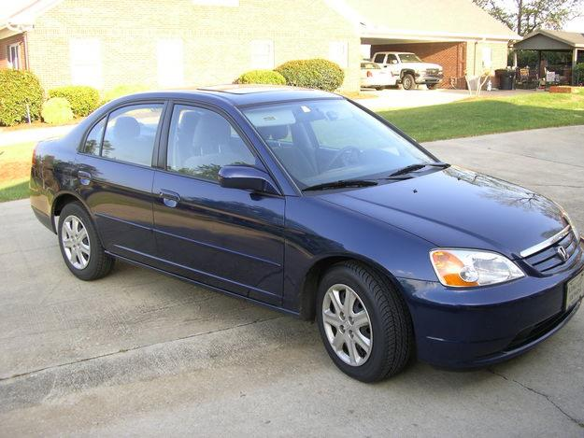
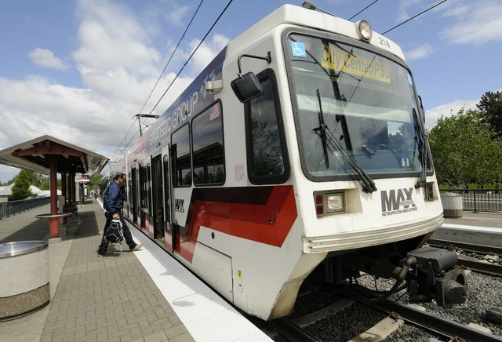
Cars
Notes:
Message:
Story To Tell:

Slide 3


Slide 4
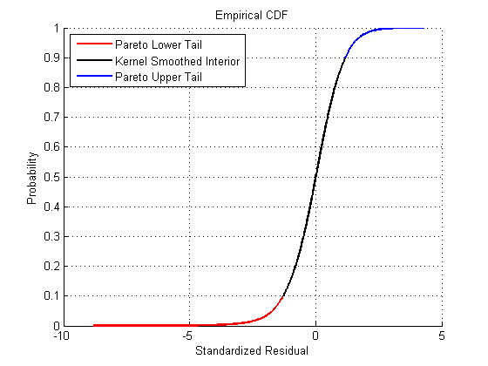
The 80/20 rule

Slide 5
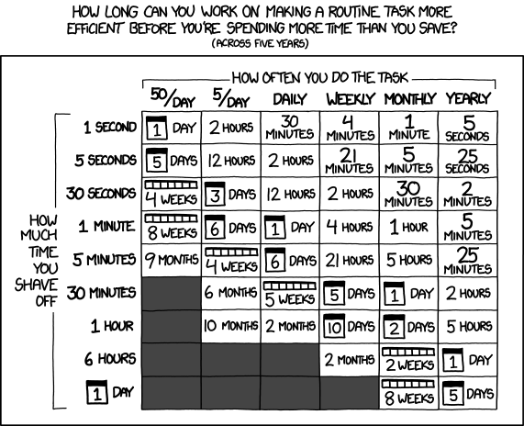
Go for great, not perfect
“The perfect is the enemy of the good”
- Voltaire, ~1750

Slide 6
Domain fundamentals
Car prices drop 15-25% each year for the first 5 years.
Cars lasting over 300K kilometers are pretty common.
Biggest cost to owning a car is depreciation.
There’s no set price for a car; you can haggle.
Nobody says which make/model/year are the most reliable

Slide 7


Principals and Agents

Slide 8

When in doubt, listen to everyone

Slide 9
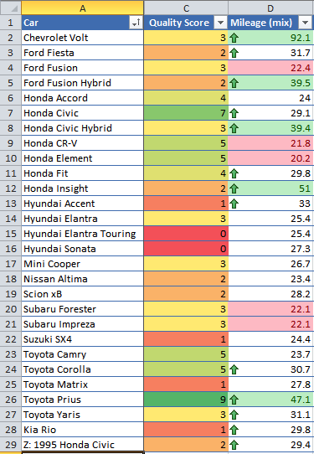

Slide 10
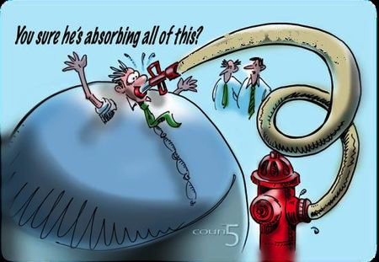
Collect ALL THE DATA!

Slide 11

Health Care

Slide 12
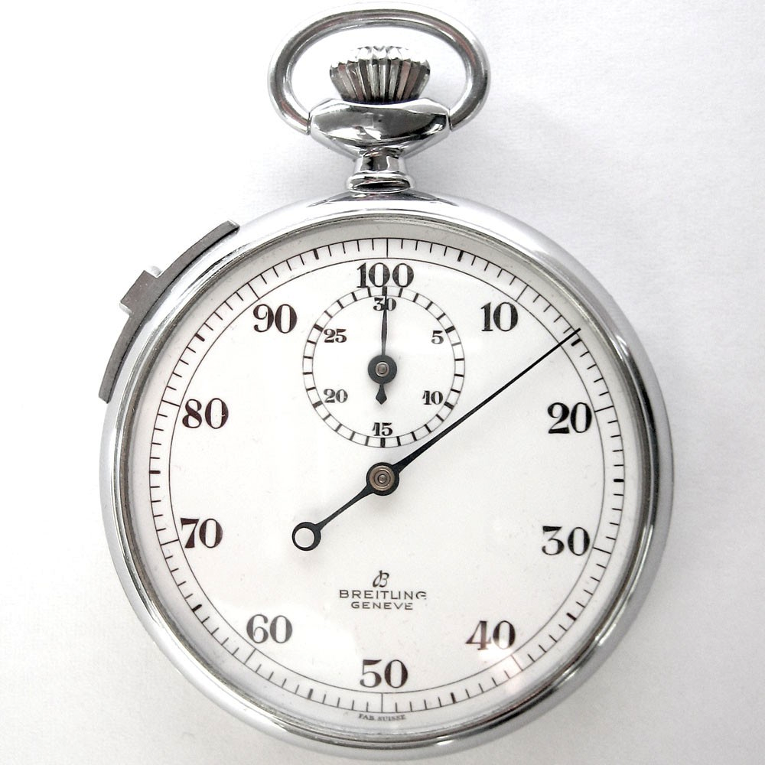
Housing

Slide 13
Know the Domain

Slide 14
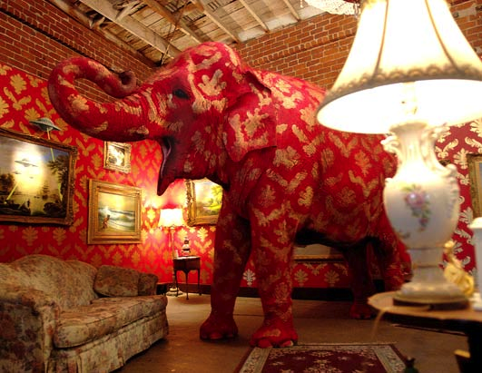
About the price…

Slide 15
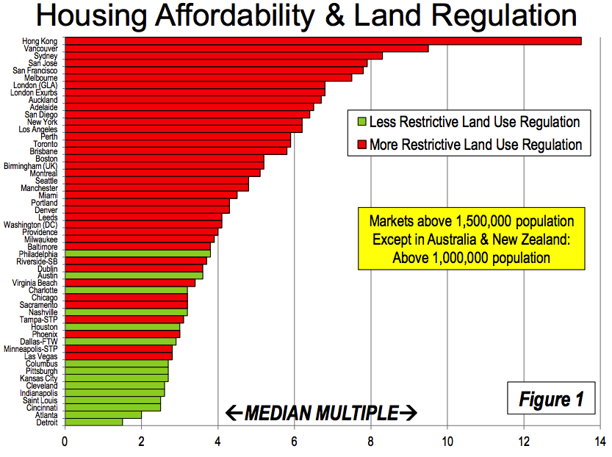

Slide 17
Scores of Houses
House | Feature | Feature Score | Feature Importance | House Score
Condo | Bathrooms | 2 | 2 | 4
Condo | Bedrooms | 2 | 3 | 6
Condo | Commute | 5 | 4 | 20
Condo | Garden | 0 | 1 | 0
Condo | Kitchen | 3 | 3 | 9
Condo | Maintenance | 5 | 3 | 15
Condo | Neighborhood | 3 | 2 | 6
Condo | Schools | 4 | 5 | 20
House A | Bathrooms | 5 | 2 | 10
House A | Bedrooms | 5 | 3 | 15
House A | Commute | 1 | 4 | 4
House A | Garden | 4 | 1 | 4
House A | Kitchen | 4 | 3 | 12
House A | Maintenance | 4 | 3 | 12
House A | Neighborhood | 2 | 2 | 4
House A | Schools | 4 | 5 | 20
House B | Bathrooms | 3 | 2 | 6
House B | Bedrooms | 2 | 3 | 6
House B | Commute | 5 | 4 | 20
House B | Garden | 4 | 1 | 4
House B | Kitchen | 4 | 3 | 12
House B | Maintenance | 1 | 3 | 3
House B | Neighborhood | 2 | 2 | 4
House B | Schools | 3 | 5 | 15

Slide 18
Resources
http://devnambi.com/analysis-resources/car-buying/
Notes:
Resources

Slide 19
Q&A
Notes:
Q&A

